Slide 1
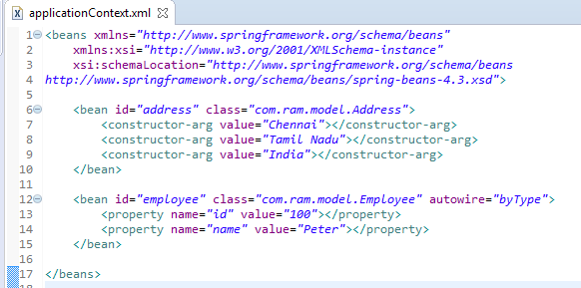

byType Auto-wiring mode in Spring
The byType auto-wiring mode injects the object dependency according to type. So property name and bean name can be different. It internally calls setter method.
In case of byType auto-wiring mode, bean id and reference name may be different. But there must be only one bean of a type. It internally uses setter injection.

